Slide 1
Jeffrey W. Holcomb

Slide 2
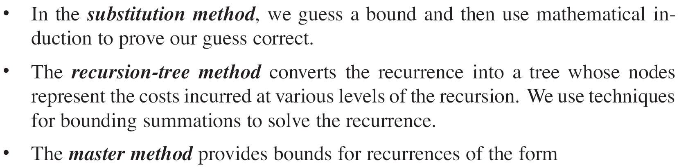
Measuring Growth of Algorithms
Hardest methods to asses are recurrences
Three methods for solving recurrences

Slide 3
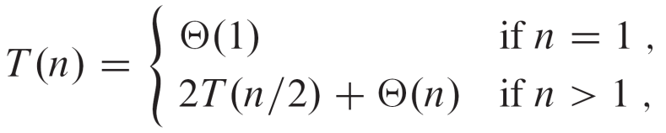

Recurrence: substitution
Recurrence for Merge-Sort
Collatz Recussion:
Start with any positive number x.
If x is even, then x ← x/2
If x is odd, then x ← 3x + 1
Halt if x = 1
Collatz Conjecture: no matter the choice of x the above recursion will always halt at x = 1.

Slide 4
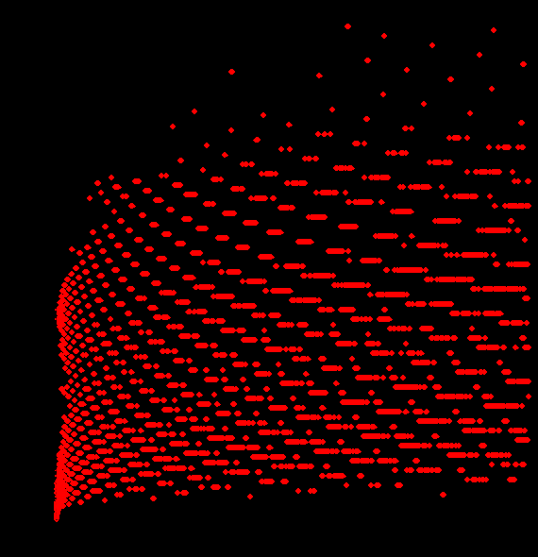
Divide and Conquer: Recurrence
Collatz Recussion: ~f(x) = (3/4)x + 1/2
In class Solve-ish

Slide 5
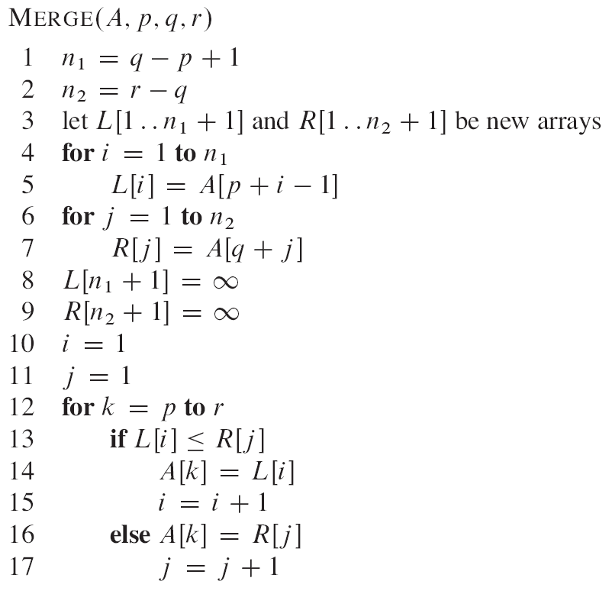
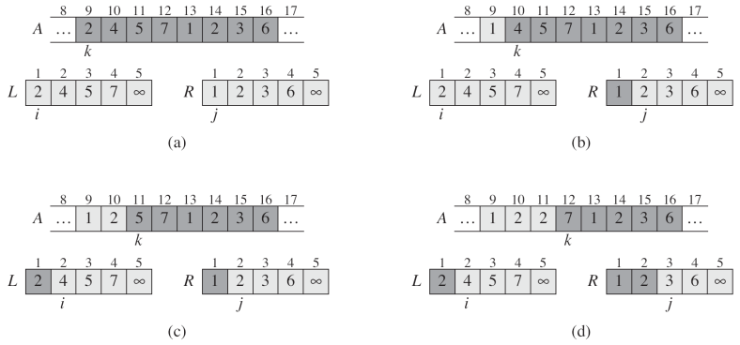
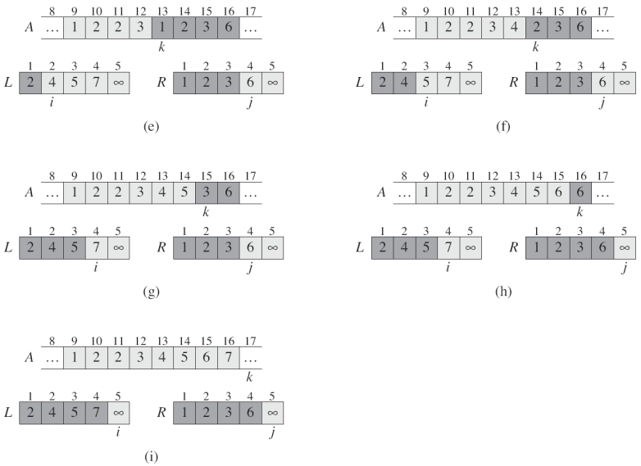
recursion tree method: Merge Sort

Slide 6
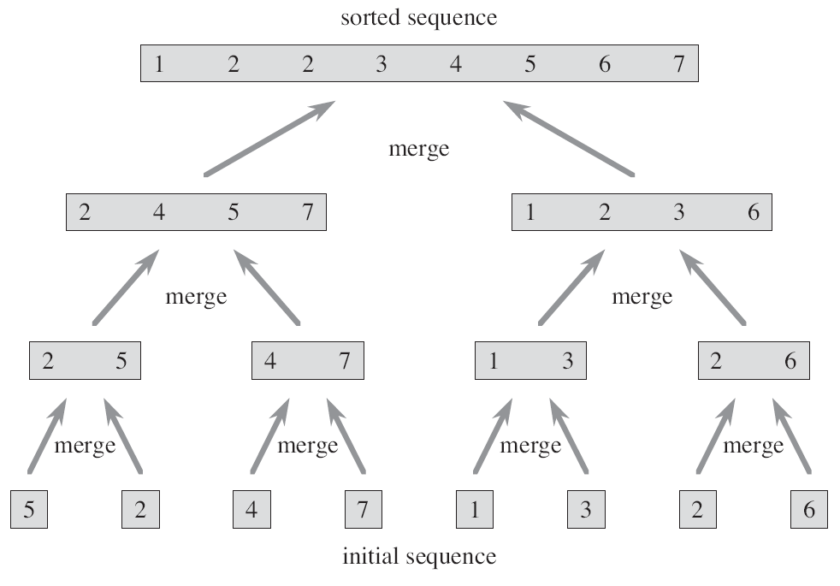
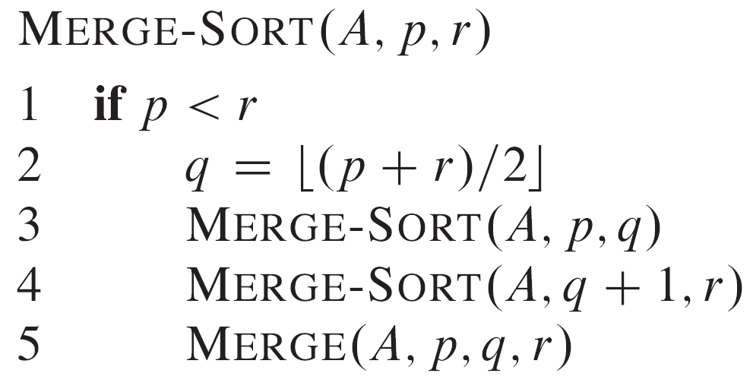
recursions

Slide 7
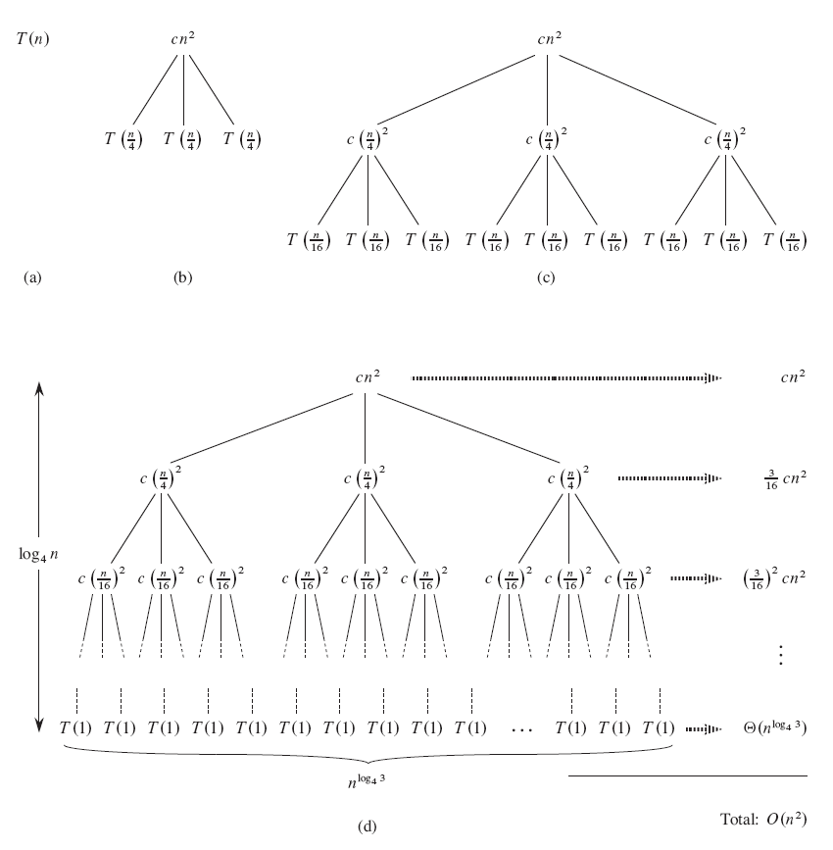
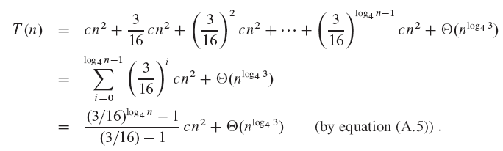
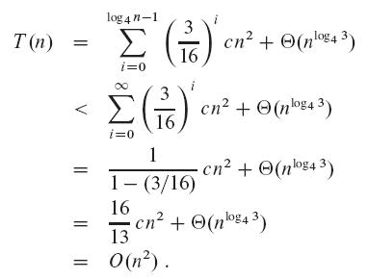
Recurrence: recursion tree for T(n) = 3T(n/4) + cn²

Slide 8
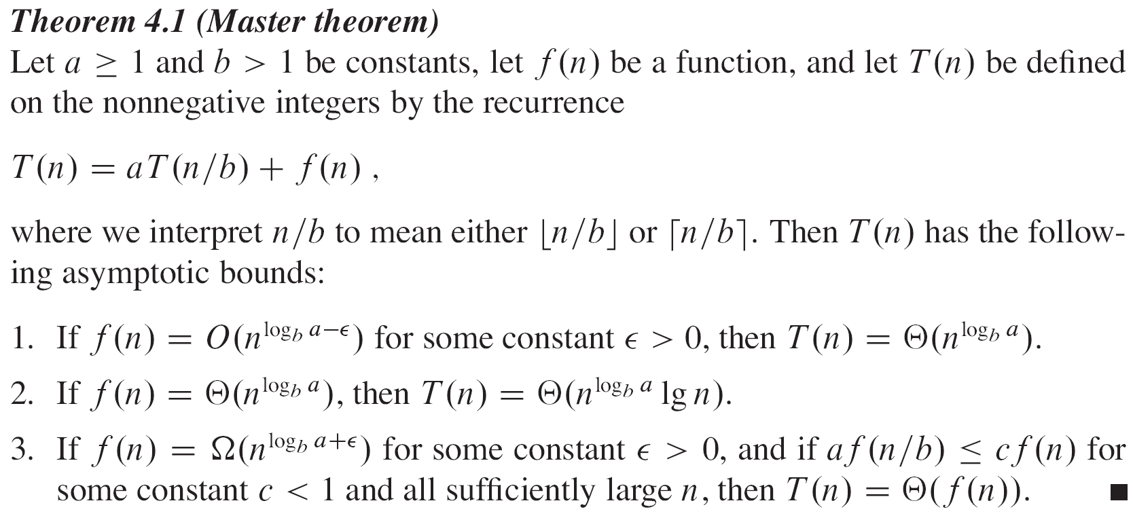
The Master Method

Slide 9
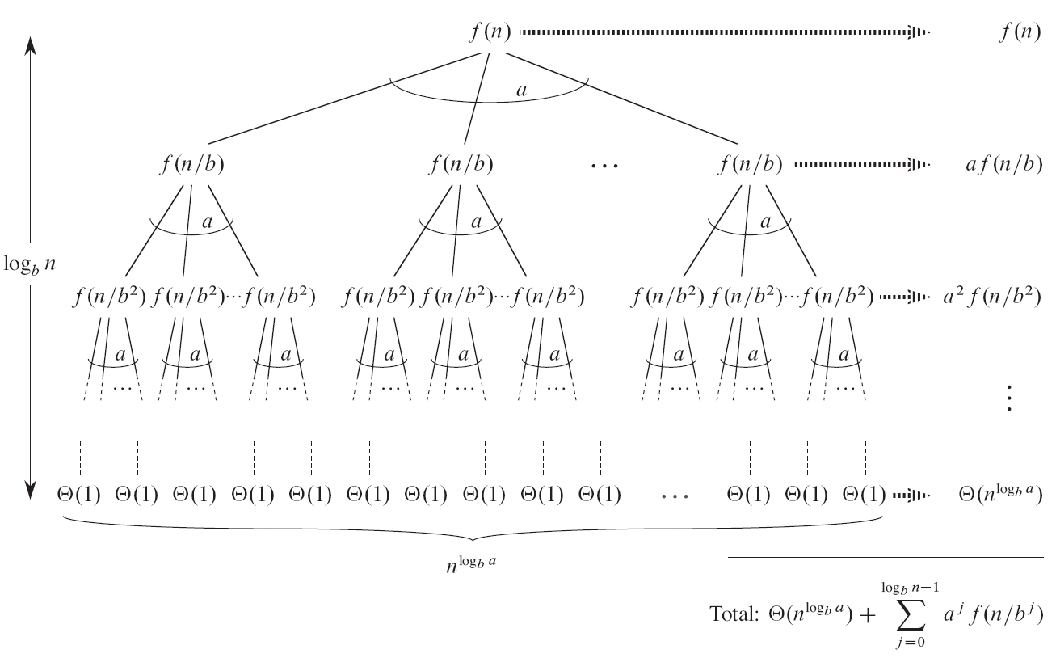
The Master Method

Slide 10
Greedy
Divide and Conquer
Dynamic

Slide 11
Greedy Algorithms
Greedy algorithms are like, bubble sort, insertion sort, etc. They take information one value at a time and process that value before moving on to the next value.

Slide 12
Divide and Conquer
Divide and conquer algorithms break a problem up into smaller pieces, solve the smaller pieces, and then combine the solution to the smaller pieces to create a solution to the entire problem.

Slide 13
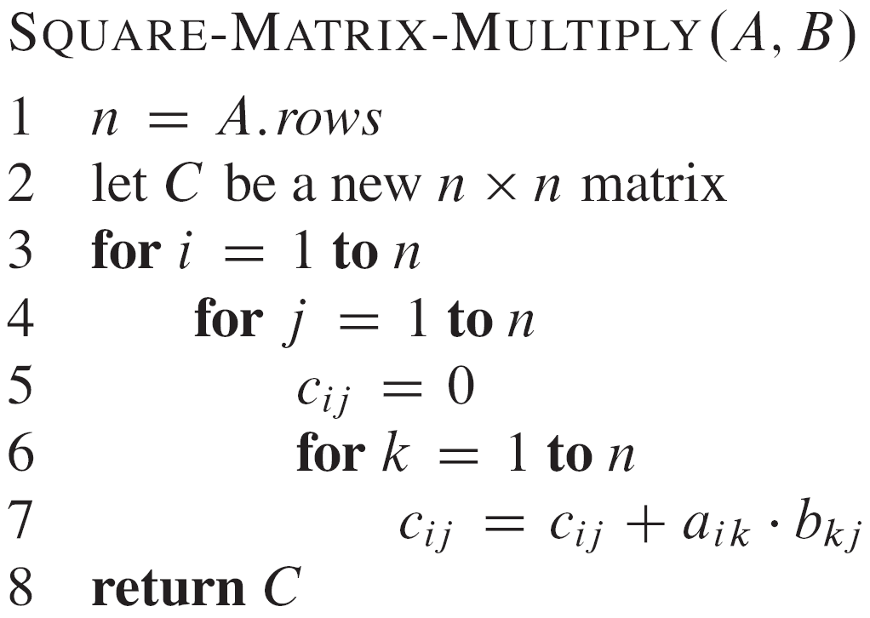
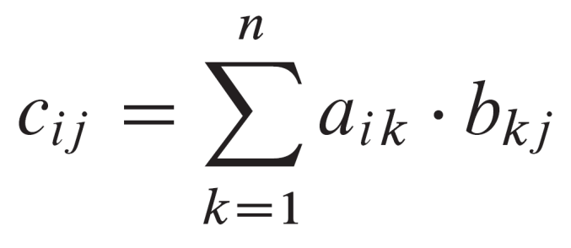
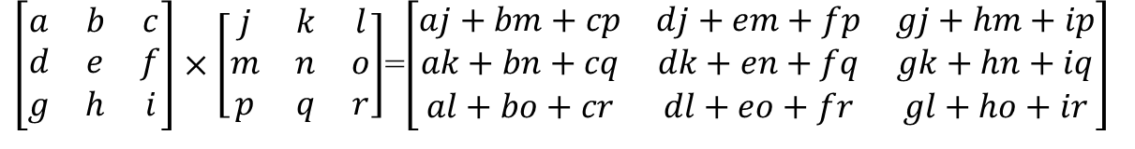
Divide and Conquer: Strassen’s algorithm for matrix multiplication
$\left[\begin{matrix}a & b & c \\ d & e & f \\ g & h & i\end{matrix}\right]×\left[\begin{matrix}j & k & l \\ m & n & o \\ p & q & r\end{matrix}\right]$=$\left[\begin{matrix}aj+bm+cp & dj+em+fp & gj+hm+ip \\ ak+bn+cq & dk+en+fq & gk+hn+iq \\ al+bo+cr & dl+eo+fr & gl+ho+ir\end{matrix}\right]$

Slide 14
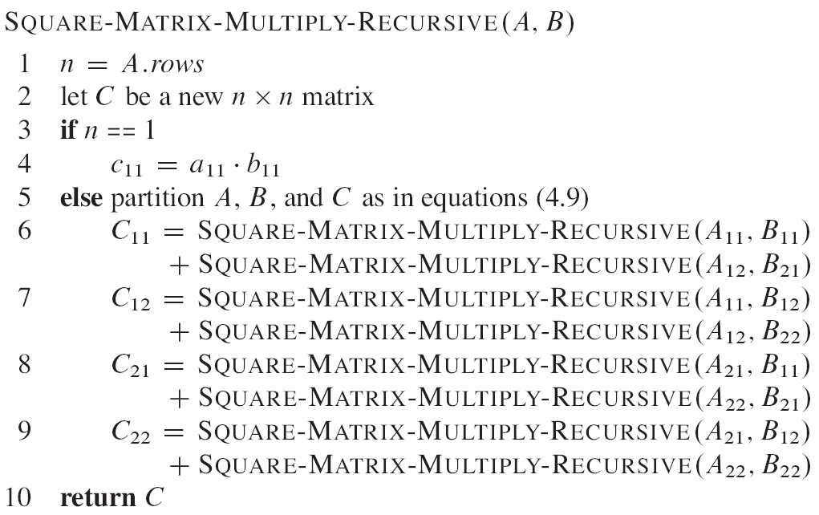
Divide and Conquer: Strassen’s algorithm for matrix multiplication

Slide 15
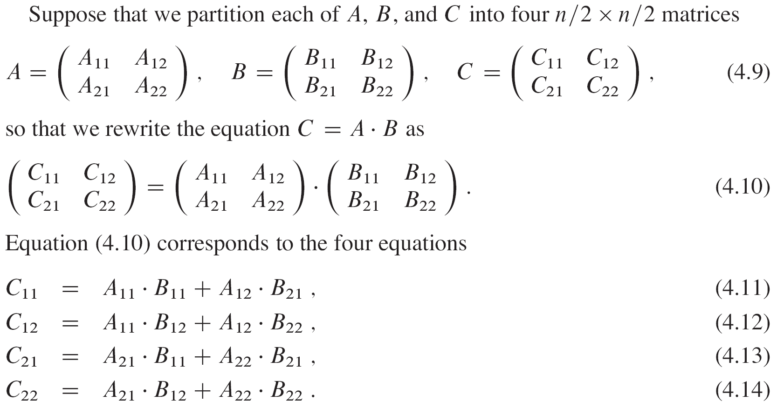
Divide and Conquer: Strassen’s algorithm for matrix multiplication

Slide 16
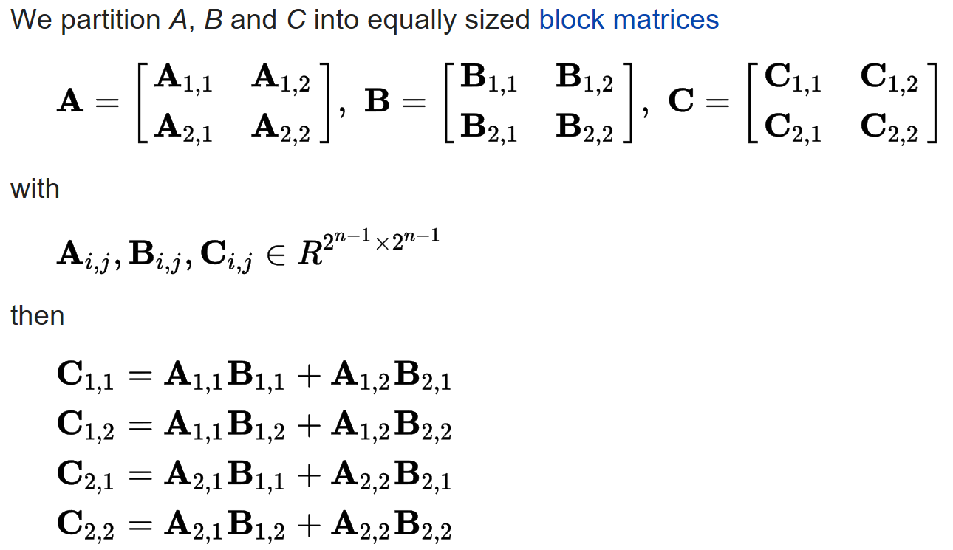
T(n) = Θ(n²)
Divide and Conquer: Strassen’s algorithm for matrix multiplication

Slide 17
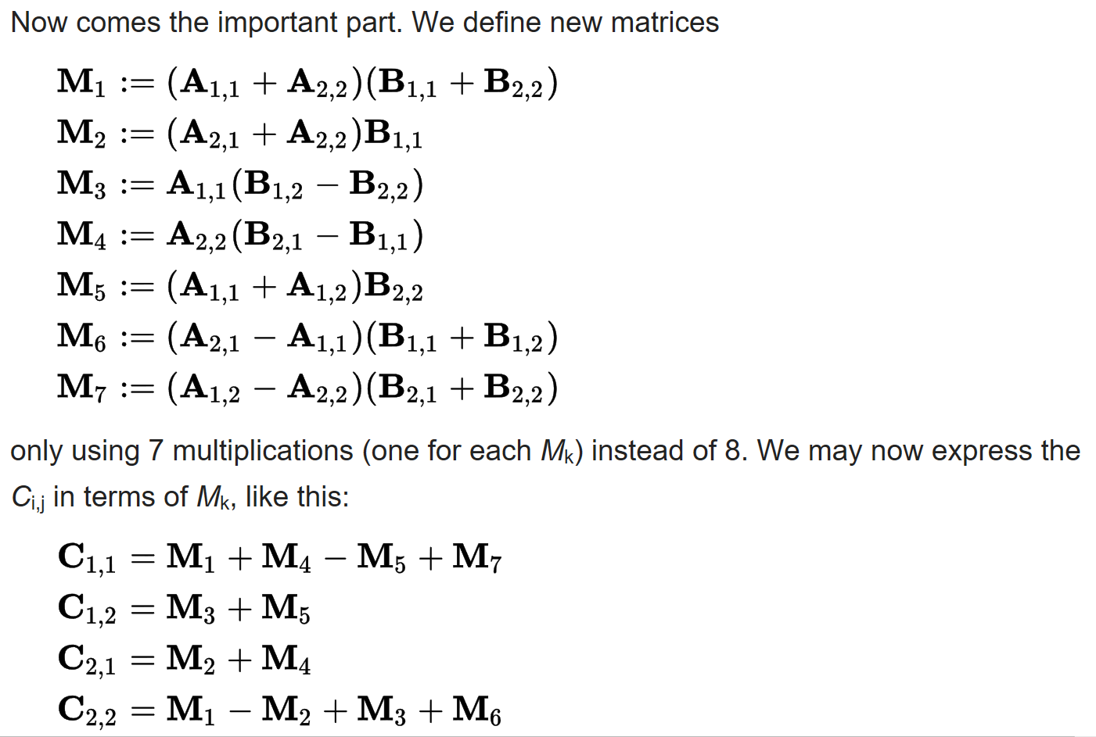
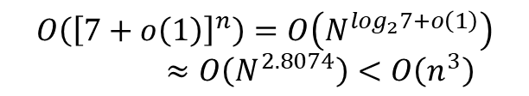
T(n) = Θ(n²)
Divide and Conquer: Strassen’s algorithm for matrix multiplication
$$O\left({\left[7+o\left(1\right)\right]}^{n}\right)=O\left(N^{\log_{2}7+o\left(1\right)}\right)≈O\left(N^{2.8074}\right)<O\left(n^{3}\right)$$

Slide 18
Dynamic Programming
Dynamic programming utilizes tables and other structures to dynamically store the state of the problem as the algorithm processes the input.

Slide 19
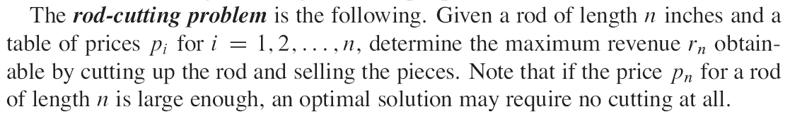
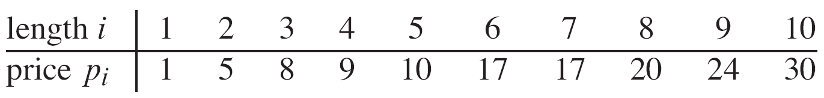
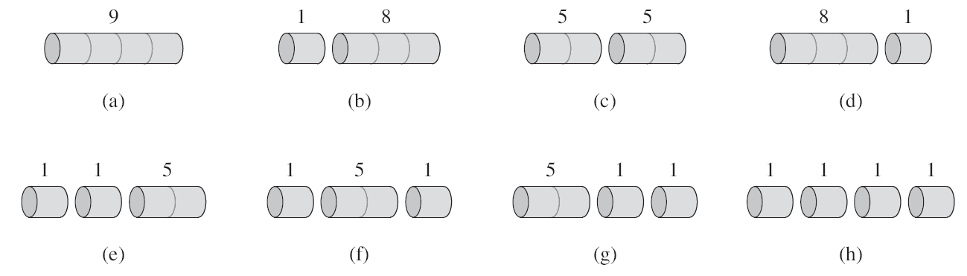
Dynamic Programming

Slide 20
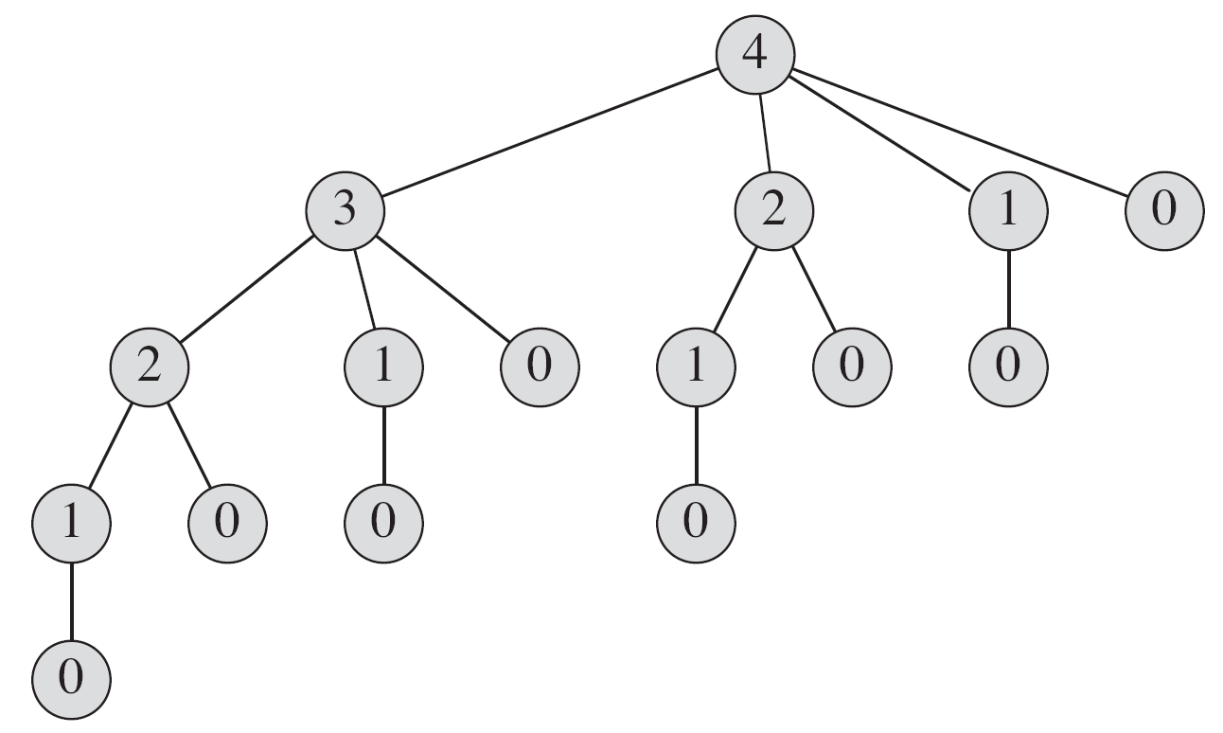
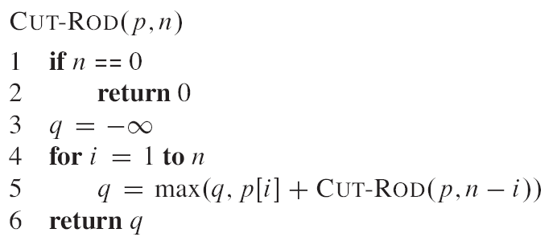
Dynamic Programming

Slide 21
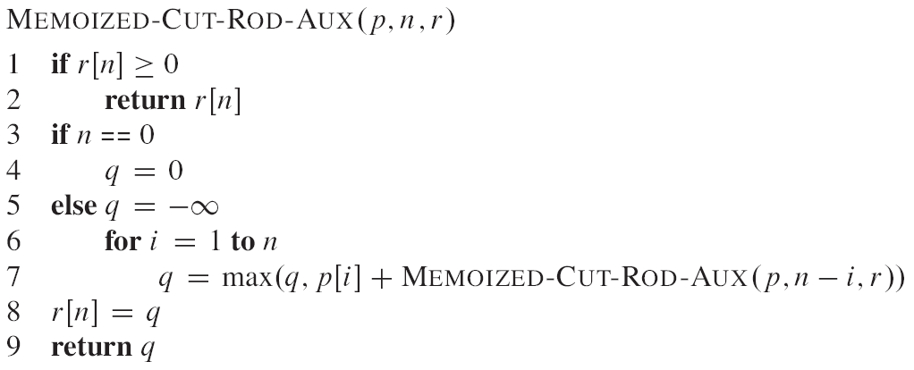
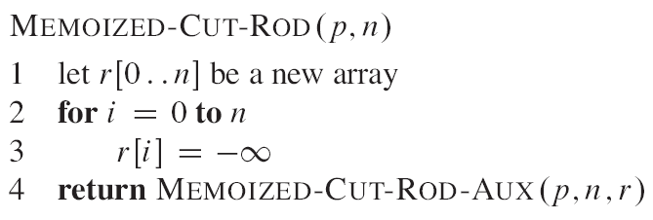
Dynamic Programming

